Slide 1
Installing WFCTSI R Package
https://github.com/bostasie/WFCTSI-Public
Download tar.gz file (the R package) to local repository
Open R or R Studio
Use R code or GUI interface in R to install package
a. R code: insert your file path in “path_to_file”
install.packages(path_to_file, repos = NULL, type="source")
b. Use R Studio Icons:
See next page

Slide 2
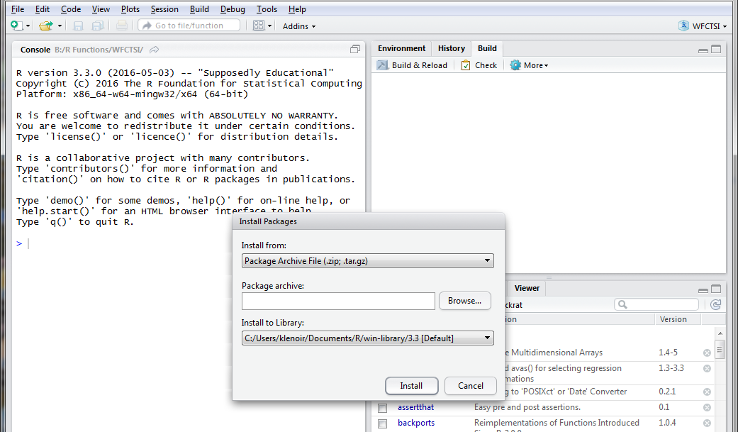
Select “Package Archive File (.zip; tar.gz)” from “Install from” drop down
Select “Browse” and choose the repository in which your tar.gz file is stored
(“Install to Library” is just your local R library. No need to modify)
Select “Install”
Once installed, call the library with R code: library(WFCTSI)

Slide 3
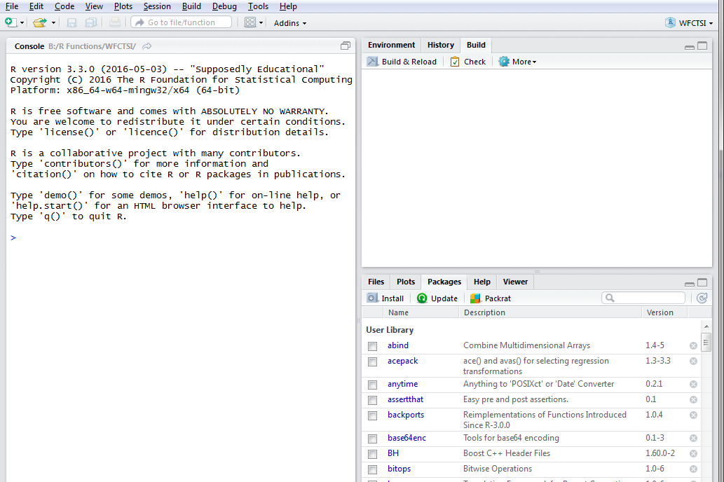
Select “tools” and drop down to “install packages”
OR
Select “Packages” and select “Install”

